Slide 1
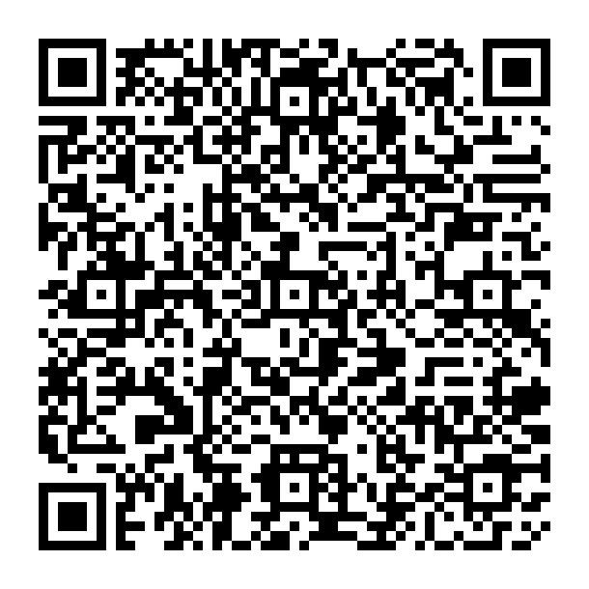
XGBOOST your Digital Ag Research
Dina Dinh, Leticia Santos, Thanos Gentimis

Slide 2
Link to Github
https://github.com/ddinh4/AI_in_Agriculture_Conference_2024

Slide 3



XGBOOST
Random Forests
Hyperparameter Optimization
A modern ML technique
A tried-and-true ML technique
A crucial Step

Slide 4
XGBOOST
Brief History
Ph.D. thesis at the University of Washington in 2014.
1
Invented by Tianqi Chen
Initially written in C++
2
Ensemble learning algorithm that combines the predictions of multiple weak predictive models, called base learners, to create a strong predictive model

Slide 5
Boosting algorithm, iteratively trains weak models and assigns higher weights to misclassified instances to improve subsequent models
3
R and Python packages came early
Now on Java, Scala, Julia, Perl, and others
4
General Framework, parallelizable, scalable, versatile, highly optimizable
Tends to replace Random Forests as the cheap, fast, easy first ML approach
5
Excellent results, relatively fast

Slide 6



Initial Prediction
Compute Residuals
Build a Tree
Start with a simple guess (e.g., the mean of the target for all instances)
Calculate the differences between observed values and predictions (i.e., the errors)
Construct a decision tree to model the residuals, aiming to predict the errors of the previous prediction

Slide 7



Predict Tree Output
Update Model
Regularization
Each leaf of the tree gives a prediction to improve the overall accuracy.
Integrate the new tree’s predictions into the existing model, adjusted by the learning rate.
Control overfitting by penalizing the complexity of the model

Slide 8



Objective Function
Optimization
Cross-Validation
Optimize a function that combines the loss (fitting error) and a regularization term
Enhance computation speed using parallel processing
Validate the model's effectiveness at each step.

Slide 9
Random Forests
Brief History
Introduced the first algorithm for random decision forests in 1995.
1
Invented by Tin Kam Ho
Concept of bagging
2
In 1996 Leo Breiman Introduced the concept of bagging (Bootstrap Aggregating)

Slide 10
Leo Breiman and Adele Cutler published in 1996 the combined Breiman's bagging idea with a random selection of features
3
Joining concepts of bagging and trees
Registration of Random Forests technique in Minitab
4
"Random Forests" was registered as a trademark by Leo Breiman and Adele Cutler in 2006
Late 2000s to Early 2010s - Implementation of Random Forests in major programming languages R (randomForest) and Python (scikit-learn).
5
R and Python implementation

Slide 11

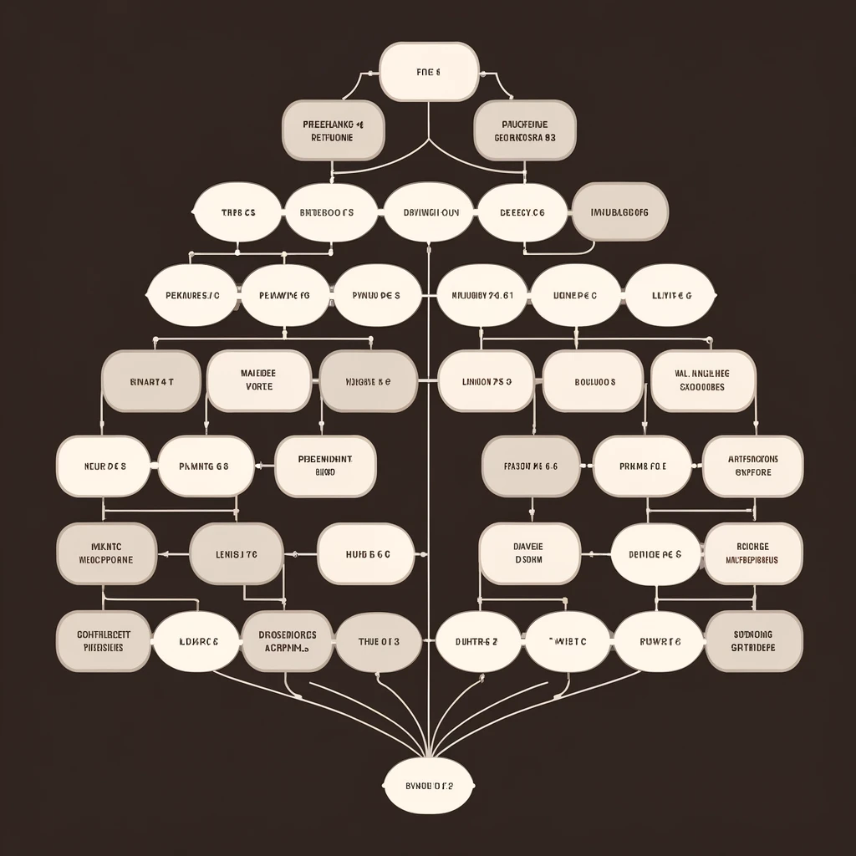

Initial Bootstrap aggregation (bagging) with replacement
Building each Decision Tree
Hyperparameter tunning
Series of if-then statements about the independent variables in a certain observation to predict a number. Repeat n_estimators times.
max_features, n_estimators, max_depth are some examples
Creation of multiple decision trees. Each tree is built from a different sample of the data.

Slide 12


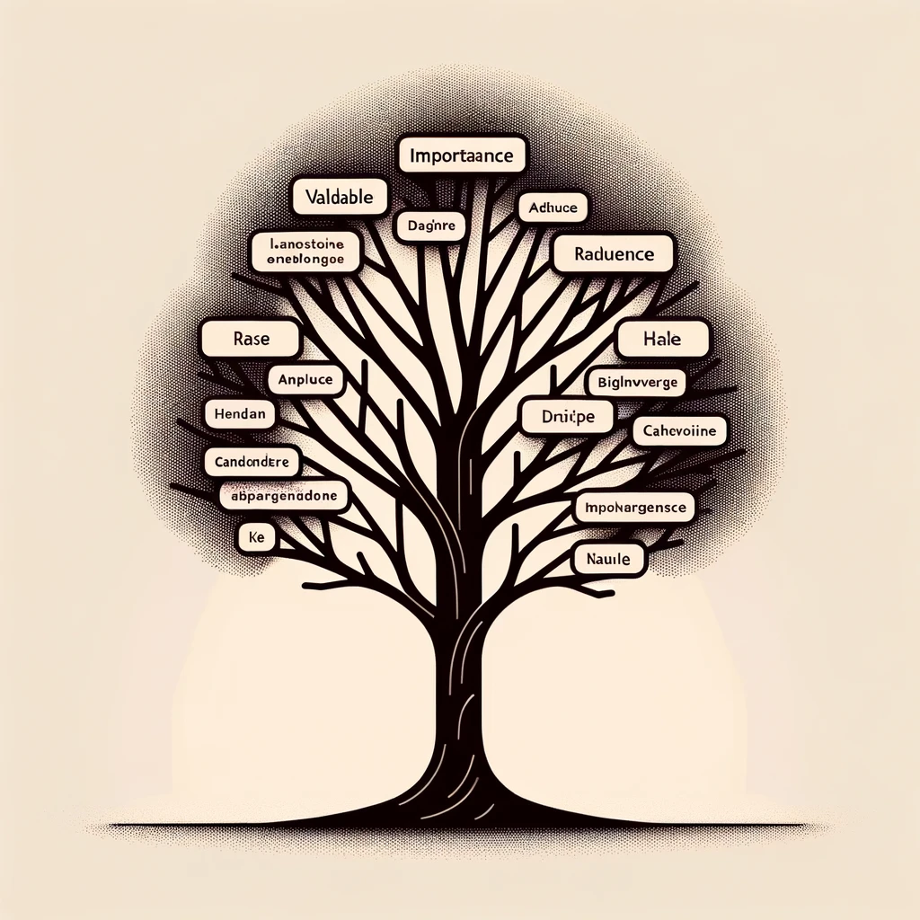
Prediction
Advantages of Randomness
Variable Importance
Classification: Based on a majority vote of all the trees in the forest.
Regression: Average of all these tree predictions
Reduces the variance of the model without increasing the bias too much, leads to better generalization
Very useful to determine variable importance, especially because of tree initialization

Slide 13

Hyperparameter Tuning
Find the “knobs” for each model you use (tutorials, lit review)
Perform tuning ALWAYS
Describe your method and results

Slide 14
Change language
I used…
Describe
A random forest, XGBOOST, neural networks
The architecture, the hyperparameters, the tuning process
I used…
Describe
Spyder, keras, tensorflow
The model you used and how it was implemented using those
Learn and update your thinking and language
I found that..
Describe
In our example …
The statistics, the cross-validation

Slide 15
Links
https://ai-jobs.net/insights/xgboost-explained/
https://discovery.hgdata.com/product/xgboost
https://en.wikipedia.org/wiki/XGBoost
https://xgboost.readthedocs.io/en/latest/parameter.html
Picture time
https://xgboost.readthedocs.io/en/stable/
https://www.datacamp.com/tutorial/xgboost-in-python

Slide 16
A Word About LLM-Generative AI
Understand
Make sure you are not “copy-pasting” but also UNDERSTANDING!
Disclose
Report how you used it, give references
It is ok, and sometimes advisable to Use it
Explore
Check sources, view tutorials and verify

Slide 17

Thank you
Questions?

